Slide 1
Sentiment analysis
Sonam Namgail
Data science
Enrollment no. : 01

Slide 2
What is sentiment Analysis ?
Take a block of text as input
Determines the sentiment expressed in it
“Sentiment” refers to whether the author’s opinion is positive or negative
Sad Anger Fearful Happy
😥 😔 😱 😃
☹️ 😡 😨 🤣

Slide 3
What sentiment analysis is not?
Does not use images anywhere ( that is “emotion detection”)

Slide 4
Why sentiment analysis is challenging?
Keywords are not usually direct
Opinions expressed may belong to other people
Order Effects
Colloquial and domain-specific phrases

Slide 5
Project Overview
Sentiment Analysis, as the name suggests, it means to identify the view or emotion behind a situation.
It basically means to analyze and find the emotion or intent behind a piece of text or speech or any mode of communication.
We, humans, communicate with each other in a variety of languages, and any language is just a mediator or a way in which we try to express ourselves. And, whatever we say has a sentiment associated with it.
It might be positive or negative or it might be neutral as well .
We can even break these principal sentiments(positive and negative) into smaller sub sentiments such as “Happy”, “Love”, ”Surprise”, “Sad”, “Fear”, “Angry” etc. as per the needs or business requirement.

Slide 6
How it works?
Input to this application is training data set and test dataset.
Using python library for machine learning the training dataset helps application to learn the emotions associated with the text like anger, fear, joy etc.
While processing the text it identifies the useful data from text and clear noise in the text.
After that it maps the emotions to its nearest associated text with high probability.
It then takes the input text and identifies the most similar or nearest possible emotions associated with it.

Slide 7
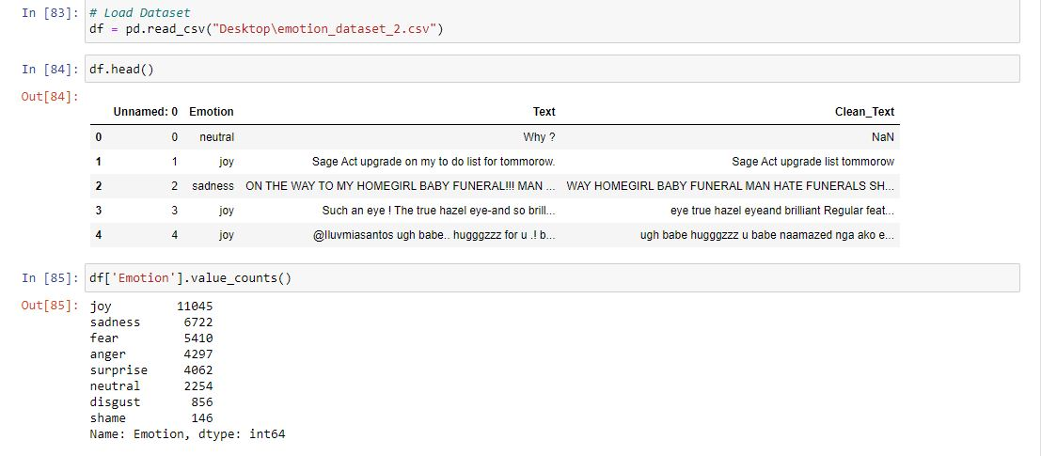
Input of training data , cleaning text

Slide 8
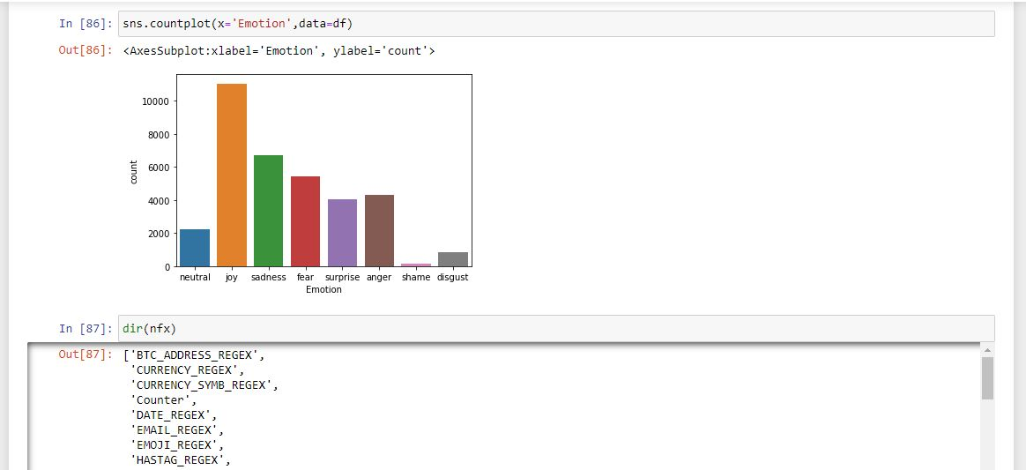
Sentiment plotting

Slide 9
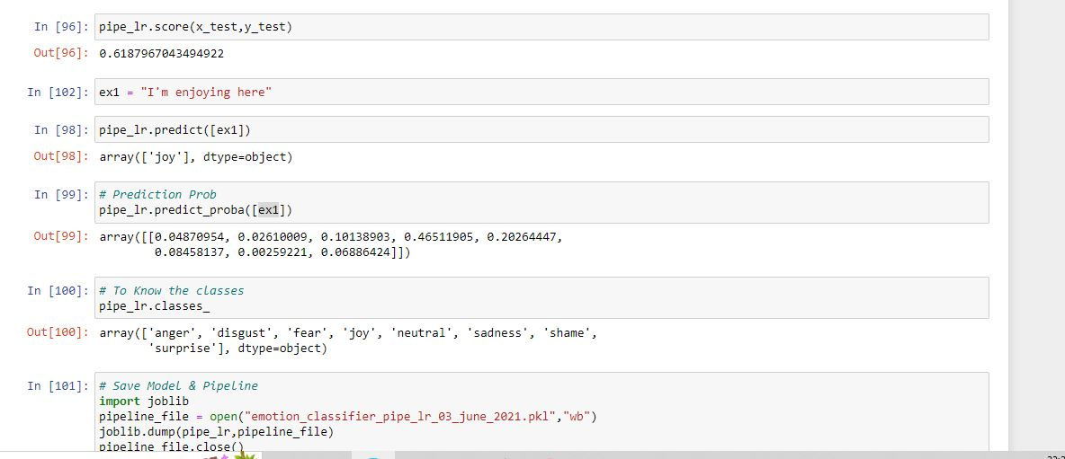
Test data , Prediction probability

Slide 10
Diving in
Module Used :
- Python standard library (sklearn, pandas, numpy, seaborn etc)
- Nltk
Classifiers used :
- Naïve Bayes ,LogisticRegression

Slide 11
Why python?
Inbuilt libraries
Simple code
Flexible paradigms (functional, procedural, object oriented, all in one)
Fast development cycle
Wide range of module

Slide 12
Additional Applications of Sentiment analysis
Filtering of spam or abusive emails
Gauging the mood of people in a particular network
Government intelligence
Psychological evaluation
Recommendation Systems
Display of ads on webpages

Slide 13
Thank you
“Sentiment is the poetry of the imagination”
-alphonsde

